Slide 1
Current Time Series Anomaly Detection Benchmarks are Flawed and are Creating the Illusion of Progress
Renjie Wu and Eamonn J. Keogh
Original figures in our paper
Dear Reader
This presentation contains all original figures in our paper.
In some cases we give some text or comments, in others we just do a screen dump of a MATLAB figure.

Slide 2
Fig. 1
1
M19 (OmniAnomaly/ServerMachineDataset/test/machine-3-11.txt , Column 19)
0
Ground Truth
diff(M19) > 0.1
M19 < 0.01
movstd(M19,10)>0.1
0
10,000
20,000
30,000

Slide 3
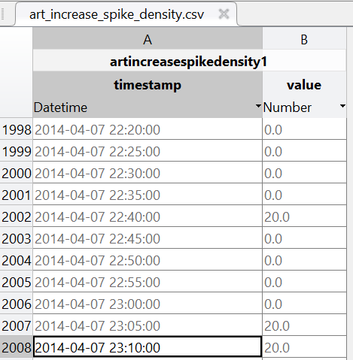
Fig. 2
>> labels = zeros(4033,1);
>> labels(2008)=1;
>> figure; subplot(211); plot(artincreasespikedensity);, subplot(212);, hold on; plot(labels+3,'r');, plot(movstd(artincreasespikedensity,5)>10,'g' )
plot(movstd(artincreasespikedensity,5)>10,'g' )
AISD: Numenta art_increase_spike_density
Ground Truth
movstd(AISD,5)>10
0
1000
2000
3000
4000

Slide 4
Fig. 3
>> figure; subplot(211); plot(real1(:,2));, subplot(212);, hold on; plot(real1(:,3)+2,'r’);, plot( real1(:,2)>0.45 ,'g');,
0.8
R1: Yahoo Real 1
0.6
0.4
0.2
0
Ground Truth
R1>0.45
0
500
1000
1500
Zoom-In
Ground Truth
R1>0.45
1200
1210
1220

Slide 5
Fig. 4
1
0.8
0.6
A1Benchmark-real32
(excerpt)
0.4
0.2
0
1100
1150
1200
1250
1300
1350
1400

Slide 6
Fig. 5
2000
A1Benchmark-real46
1000
0
Labels
D
C
0
500
1000
1500
1800
C
400
D

Slide 7
Fig. 6
A1Benchmark-real47
(excerpt)
E
F
550
640

Slide 8
Fig. 7
8
A1Benchmark-real67 (excerpt): Original Labels
6
log(original units)
4
2
0
8
A1Benchmark-real67 (excerpt): Proposed Label
6
log(original units)
4
2
0
1260
1300
1340
1380
1420

Slide 9
Fig. 8
NYC marathon, Thanksgiving, Christmas, New Year’s day, and a blizzard.
New York Taxi Demand
Daylight savings
Blizzard
Independence day
Marathon
Grand Jury Decision
Climate March
Thanksgiving
BLM march
MLK day
Discord score
Labor day
Comic Con
Xmas
New year
July 1st (2014)
Jan 31st (2015)

Slide 10
Fig. 9

Slide 11
Fig. 10
>> A1RightmostWindow = [0.8570; 0.9917; 0.9911; 0.9972; 0.3579; 0.9951; 0.9789; 0.8570; 0.9001; 0.9917; 0.9840; 0.9965; 0.9951; 0.2425; 0.9951; 0.9240; 0.9459; 0.2888; 0.9459; 0.8994; 0.9880; 0.9563; 0.9894; 0.9911; 0.9707; 0.8063; 0.9159; 0.8661; 0.8661; 0.9938; 0.9159; 0.9047; 0.9965; 0.9159; 0.4148; 0.9909; 0.9152; 0.9159; 0.9159; 0.8467; 0.9882; 0.8604; 0.4148; 0.8757; 0.8661; 0.9159; 0.2502; 0.2888; 0.9958; 0.9159; 0.8694; 0.9911; 0.2389; 0.9159; 0.9159; 0.8661; 0.9707; 0.9959; 1.0000; 0.9987; 0.9951; 0.9909; 0.9909; 0.9965];
>> hist(A1RightmostWindow,40)
35
30
Location of the rightmost anomaly label for the Yahoo A1 datasets, normalized as a percentage of the full length.
25
20
15
10
5
0
0%
100%

Slide 12
Fig. 11
0
2000
4000
6000
8000
10000
Premature ventricular contraction
(PVC)
ECG V
Plethysmograph
5100
5300
5500
5700
5900

Slide 13
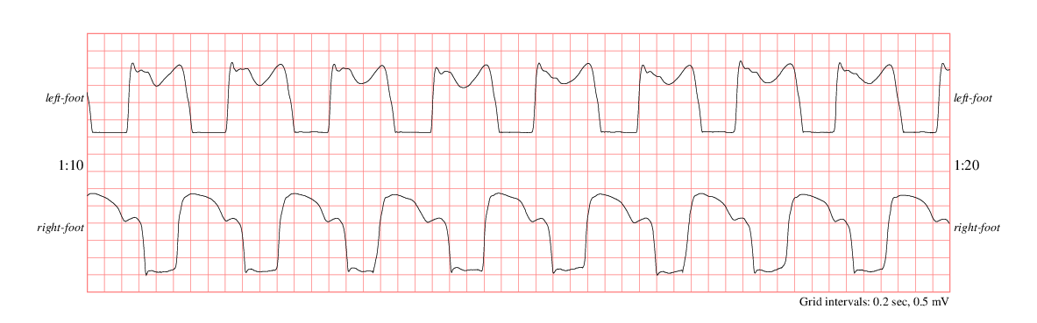
Fig. 12
UCR_Anomaly_park3m_60000_72150_72495.txt
1000
0
-1000
-2000
0
90,000
Weight acceptance
(heel down)
Push off
Right foot
(original)
Right foot
(induced anomaly)
0
1000
2000

Slide 14
Fig. 13
0
-500
E0509m: Original
-1000
Telemanom
Discord
0
-500
E0509m: Added noise
-1000
Maximum value
Telemanom
Discord
0
5000
10000
15000

